Slide 1
Tableau Assignment_1
File created on: 1/26/2024 7:31:25 AM

Slide 2
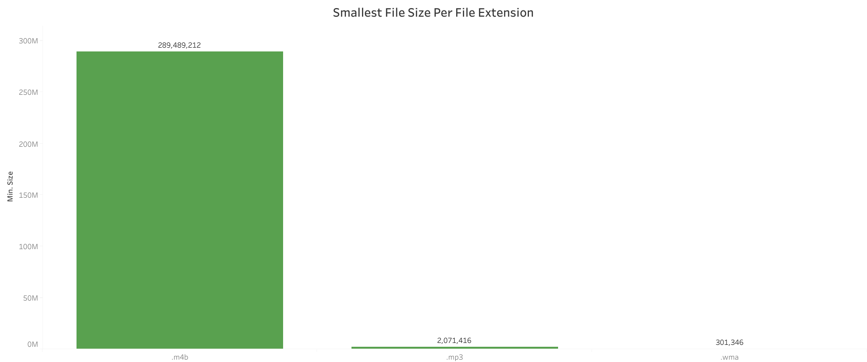

Slide 3
